Slide 1

Multiple and Hybrid Inheritance
By : Joel jacob john
Id: stb03002

Slide 2
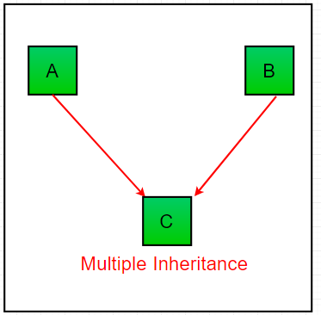
Multiple Inheritance
When a class can be derived from more than one base class this type of inheritance is called multiple inheritances. In multiple inheritances, all the features of the base classes are inherited into the derived class.

Slide 3
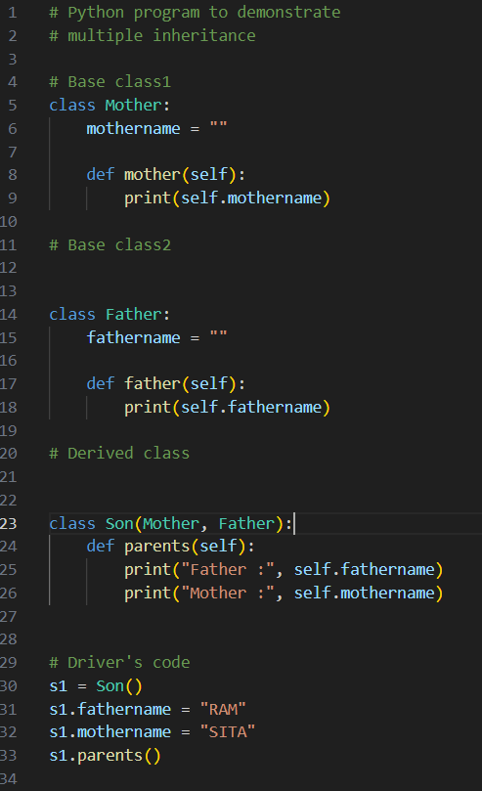
Code Example

Slide 4
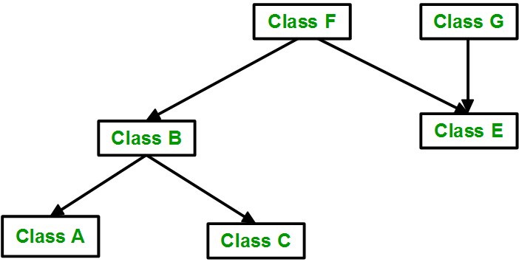
Hybrid Inheritance
A combination of multiple and multilevel inheritances so as to form a lattice structure.

Slide 5
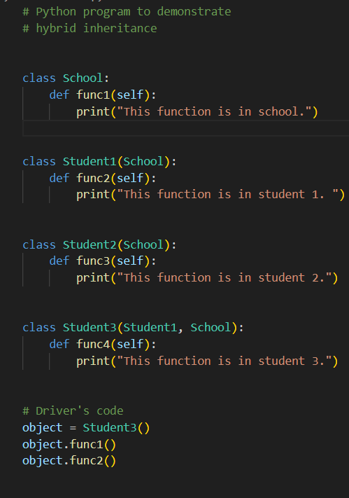

Code Example

Slide 6
Thank You

